Slide 1
Health Care Facilities
Top Ten Violations in Health Care: FY 2016-2019
Bloodborne Pathogens (1910.1030)
Hazard Communication (1910.1200)
Reporting Fatalities, Hospitalizations, Amputations, and Losses of an Eye to OSHA (1904.39)
Electrical – General Requirements (1910.303)
Personal Protective Equipment – General Requirements (1910.132)
Respiratory Protection (1910.134)
Electrical – Wiring Methods (1910.305)
Lockout/Tagout (1910.147)
Recordkeeping Forms and Recording Criteria (1904.29)
Exit Routes: Maintenance, Safeguards, and Operational Features (1910.37)
Notes:
This is a list of the top 10 most frequently cited OSHA standards following inspections of health care facilities by federal OSHA (all federal RIDs) from FY 2016 to FY 2019. This list can alert employers to these commonly cited standards so they can take steps to find and fix recognized hazards addressed in these and other standards before OSHA shows up.
This list is based on NAICS Code 62 (Health Care and Social Assistance), excluding 624 (Social Assistance).
The following slides show the top 5 sub-sections that OSHA cites for each of these standards.

Slide 2
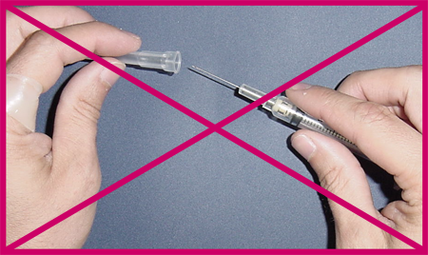
Health Care Facilities
Top Ten Violations: FY 2016-2019
(with top 5 sections cited)
1) 1910.1030 – Bloodborne Pathogens
1910.1030(c)(1)(i) (122 violations) – exposure control plan
1910.1030(g)(2)(i) (89 violations) – training employees with occupational exposure
1910.1030(c)(1)(iv) (72 violations) – review and update of exposure control plan
1910.1030(d)(2)(i) (59 violations) – engineering and work practice controls
1910.1030(c)(1)(v) (57 violations) – exposure control plans: input from non-managerial employees

Slide 3
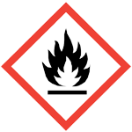
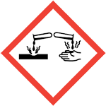
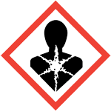
Health Care Facilities
Top Ten Violations: FY 2016-2019
(with top 5 sections cited)
2) 1910.1200 – Hazard Communication
1910.1200(e)(1) (136 violations) – written hazard communication program
1910.1200(h)(1) (111 violations) – employee information and training
1910.1200(g)(8) (45 violations) – maintaining copies of Safety Data Sheets in the workplace and ensuring that they are readily available to employees
1910.1200(g)(1) (27 violations) – having Safety Data Sheets in the workplace for each hazardous chemical
1910.1200(e)(1)(i) (26 violations) – elements of hazard communication program: list of hazardous chemicals

Slide 4
Health Care Facilities
Top Ten Violations: FY 2015-2018
(with top 5 sections cited)
3) 1904.39 – Reporting Fatalities, Hospitalizations, Amputations, and Losses of an Eye to OSHA
1904.39(a)(2) (104 violations) – reporting to OSHA within 24 hours of hospitalization, amputation, or loss of eye
1904.39(a)(1) (7 violations) – reporting to OSHA within 8 hours of work-related death
1904.39(a)(3) (3 violations) – methods for reporting
1904.39(b)(7) (2 violations) – procedure if don’t learn of reportable incident right away
1904.39(a) (1 violation) – basic reporting requirement

Slide 5
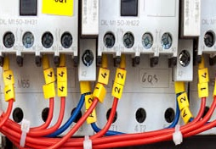
Health Care Facilities
Top Ten Violations: FY 2016-2019
(with top 5 sections cited)
4) 1910.303 – Electrical, General Requirements
1910.303(b)(2) (38 violations) – installing and using listed or labeled equipment in accordance with instructions included in the listing or labeling
1910.303(g)(1) (22 violations) – sufficient access and working space about electrical equipment (600 volts, nominal, or less to ground)
1910.303(g)(1)(ii) (12 violations) – no use of working space for storage, and guarding working space
1910.303(g)(2)(i) (10 violations) – guarding live parts (600 volts, nominal, or less to ground)
1910.303(f)(2) (7 violations) – marking service, feeder, and branch circuits at their disconnecting means or overcurrent device

Slide 6
Health Care Facilities
Top Ten Violations: FY 2016-2019
(with top 5 sections cited)
5) 1910.132 – Personal Protective Equipment
1910.132(d)(1) (39 violations) – hazard assessment
1910.132(d)(2) (20 violations) – written certification of hazard assessment
1910.132(a) (19 violations) – when PPE must be provided
1910.132(d)(1)(i) (9 violations) – selection and use of PPE to protect against hazards identified in hazard assessment
1910.132(f)(1) (7 violations) – training of employees required to use PPE

Slide 7
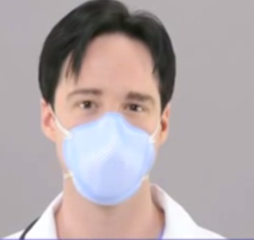
Health Care Facilities
Top Ten Violations: FY 2016-2019
(with top 5 sections cited)
6) 1910.134 – Respiratory Protection
1910.134(c)(1) (14 violations) – written respiratory protection program
1910.134(e)(1) (12 violations) – medical evaluation to determine employee’s ability to use a respirator
1910.134(d)(1)(iii) (10 violations) – respirator selection: evaluation of respiratory hazards in workplace
1910.134(c)(2)(i) (8 violations) – providing respirators at request of employees or permitting employees to use their own respirators
1910.134(f)(2) (8 violations) – fit testing for employees using a tight-fitting facepiece respirator: testing frequency

Slide 8
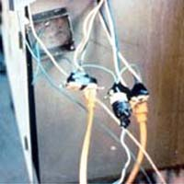
Health Care Facilities
Top Ten Violations: FY 2016-2019
(with top 5 sections cited)
7) 1910.305 – Electrical, Wiring Methods
1910.305(g)(1)(iv)(A) (14 violations) – not using flexible cords and cables as a substitute for the fixed wiring of a structure
1910.305(b)(2)(i) (13 violations) – providing pull boxes, junction boxes, and fittings with covers identified for the purpose
1910.305(b)(1)(ii) (10 violations) – closing unused openings in cabinets, boxes, and fittings
1910.305(g)(2)(iii) (7 violations) – connecting flexible cords and cables to devices and fittings so that strain relief is provided that will prevent pull from being directly transmitted to joints or terminal screws
1910.305(b)(1) (4 violations) – conductors entering boxes, cabinets, or fittings

Slide 9
Health Care Facilities
Top Ten Violations: FY 2016-2019
(with top 5 sections cited)
8) 1910.147 – Lockout/Tagout
1910.147(c)(4)(i) (22 violations) – developing, documenting, and utilizing energy control procedures
1910.147(c)(6)(i) (17 violations) – periodic inspection of energy control procedure at least annually
1910.147(c)(7)(i) (7 violations) – training on the energy control program
1910.147(c)(4)(ii) (5 violations) – elements of energy control procedure
1910.147(c)(7)(i)(A) (5 violations) – training on energy control program: recognition of hazardous energy sources, type and magnitude of energy available in the workplace, and methods and means necessary for energy isolation and control

Slide 10
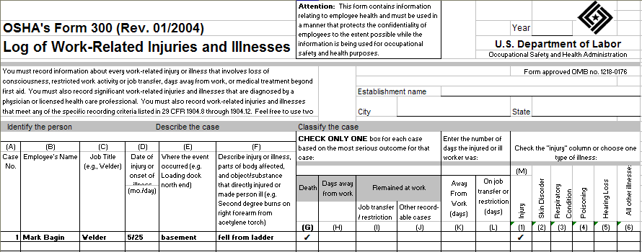
Health Care Facilities
Top Ten Violations: FY 2016-2019
(with top 5 sections cited)
9) 1904.29 – Recordkeeping Forms and Recording Criteria
1904.29(b)(1) (28 violations) – completing the OSHA 300 Log
1904.29(b)(3) (22 violations) – time limit for recording each injury or illness
1904.29(a) (15 violations) – requirement to use OSHA 300, 300-A, and 301 forms or equivalent
1904.29(b)(6) (8 violations) – when not to put employee’s name on forms for privacy reasons
1904.29(b)(2) (6 violations) – when to complete the OSHA 301 incident report

Slide 11
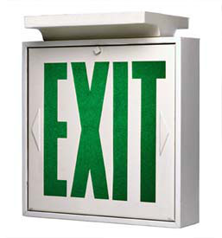
Health Care Facilities
Top Ten Violations: FY 2015-2018
(with top 5 sections cited)
10) 1910.37 – Exit Routes: Maintenance, Safeguards and Operational Features
1910.37(b)(2) (27 violations) – exits must be visible and marked with “Exit” sign
1910.37(a)(3) (18 violations) – exit routes must be free and unobstructed
1910.37(b)(4) (11 violations) – direction of travel to the exit or exit discharge
1910.37(b)(5) (7 violations) – marking of doorways or passages along an exit access that could be mistaken for an exit
1910.37(b)(6) (4 violations) – illumination of exit signs

